Slide 1
LiU CTF Preparatory Workshop

Slide 2
Atomic JavaScript

Slide 3
'NaN': '+[![]]'
'Function': '[]["flat"]'
'String': '([]+[])'
'false': '![]'
'Number': '(+[])'
AJS in practice!
'Boolean': '(![])'
'undefined': '[][[]]'
'true': '!![]'
'Array': '[]'

Slide 4
AJS DEMO

Slide 5
DNS spoofing
Domain Name System (DNS) translates domain names
(e.g. example.com)
to IP-addresses.
DNS-spoofing is an
attack where the attacker manipulates the DNS response to redirect the victim to a malicious website.
It can be used in several types of attacks for example Man-in-the-Middle.

Slide 6
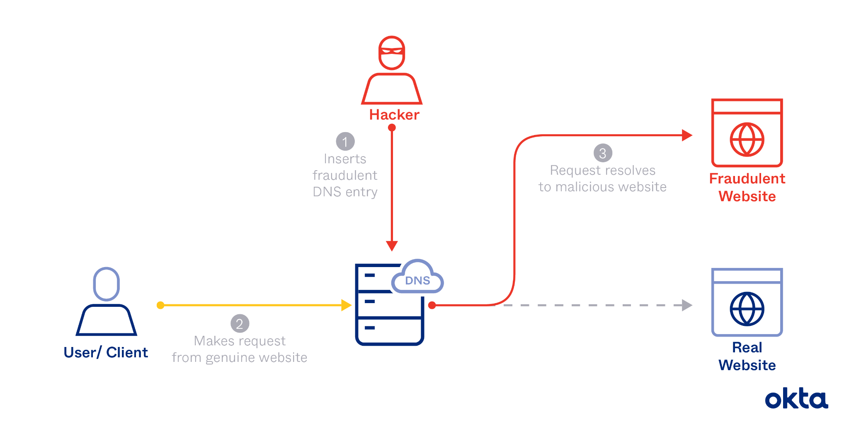

Slide 7
How
DNS spoofing
works in practice
1
The attacker spoof the DNS record, either on your computer or in the DNS-server, changing the IP-address of a domain.
2
The victim tries to visit the legitimate domain but is redirected to a malicious website.
3
This can lead to password capture, malware infection and much more…

Slide 8
DNS spoofing
DEMO

Slide 9
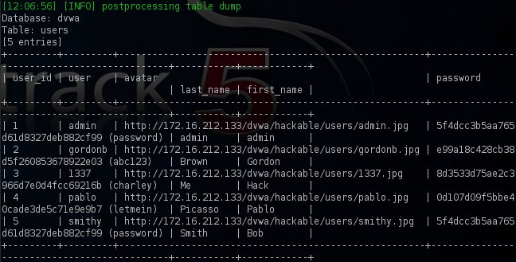
[PERSON X] Intro om attacken
SQL Injection attacks
Exposing & modifying data

Slide 10
SQL Injection attacks in practice
SELECT * FROM students WHERE studentId = ‘$studentId‘;
GET http://students.com/?studentId=117
SELECT * FROM students WHERE studentId = ‘117’;
GET http://students.com/?studentId=117’ OR 1=1; --
SELECT * FROM students WHERE studentId = ‘$studentId’ OR 1=1’; --;
source: https://medium.com/@aayushtiruwa120/dvwa-sql-injection-91b4efb683e4

Slide 11
SQL Injection attacks in practice
# GET http://students.com/?studentId=117 OR 1=1
@app.route(“/”, methods=[“GET”])
def search_users():
studentId = request.args.get(“studentId”, ''”)
conn = get_db_connection()
cur = conn.execute(f"SELECT * FROM students WHERE studentId = {studentId}")
students = [dict(row) for row in cur.fetchall()]
conn.close()
return jsonify(students)
# GET http://example.com/users/420 OR 1=1 --
@app.route(“/users/<int:user_id>”, methods=[“GET”])
def get_user(user_id):
conn = get_db_connection()
cur = conn.execute(f"SELECT * FROM users WHERE id = {user_id} LIMIT 1")
users = [dict(row) for row in cur.fetchall()]
conn.close()
return jsonify(users)
Techniques and queries
'UNION SELECT column_name FROM information_schema.columns WHERE table_name= 'users' –
'UNION SELECT table_name FROM information_schema.tables --
INSERT command to modify data, DROP TABLE students to destroy data…
sqlmap -u 'http://students.com/?studentId=117' -p studentId --dump

Slide 12
[PERSON X] Intro om
SQL Injection demo!
Damn Vulnerable Web app

Slide 13
Steganography

Slide 14
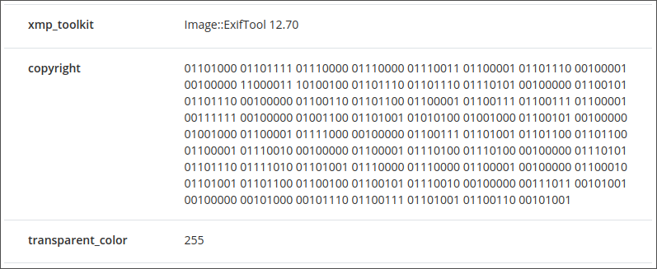
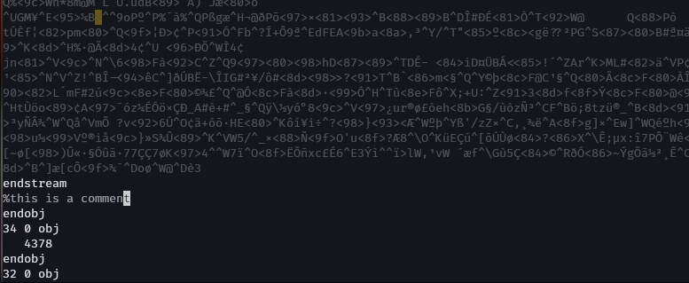
In practice
There are many ways to hide data in files!
By hiding it in metadata:
Easy to do
Easy to find
By exploiting the file type:
Harder to do
Harder to find

Slide 15
Demo time!

Slide 16
Password cracking
Notes:
Pwd cracking = guessing passwords until one work
Can guess via login system, but most likely will get blocked/flagged
Solution: passwords are not stored in plaintext (hopefully…), their hash values are stored
Hash value: a unique input gives a unique, but transformed output of some fixed length
If we get the hash value, we can try to calc hash values on passwords until we get a match -> we got the password
Usage: forensics, pentesting, and naughty usage..

Slide 17
In practice
OS Hash locations:
Windows: SAM database
Linux: /etc/shadow
Common tools:
Hashcat
John the Ripper
+ Wordlists

Slide 18
Prevention
Good password
Aka not “123”
Length, complexity
Salting
Rainbow table attacks
Protecting hashes
“Better” hash algorithms
Slower

Slide 19
Let’s guess a password!

Slide 20
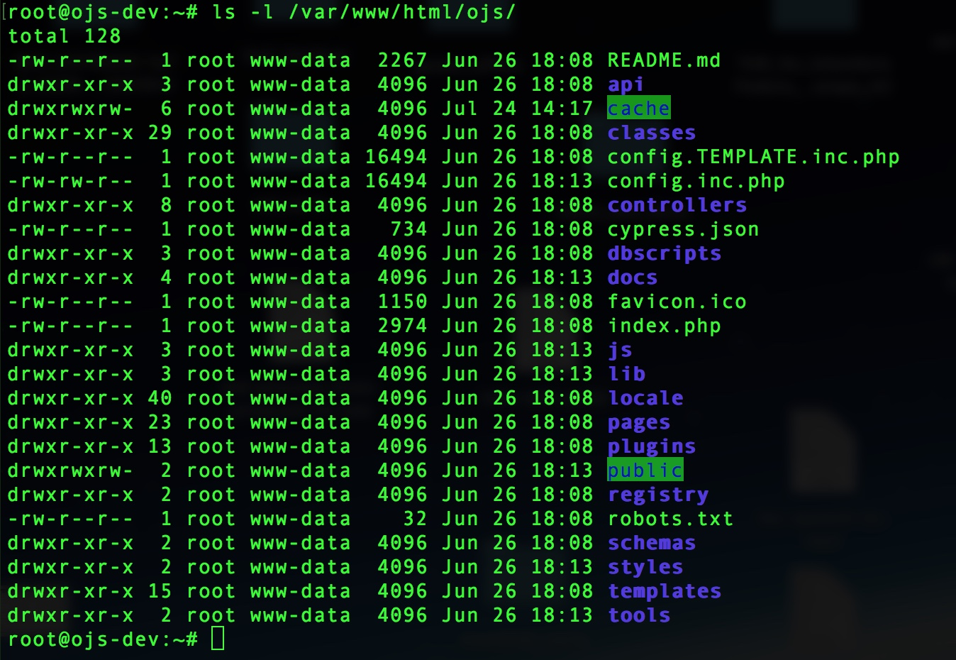
Web hacking
for CTFs

Slide 21
Web hacking in practice
ctrl + shift + I
F12
ctrl + U
Computer Security
- TSIT02

Slide 22
Web CTF DEMO

Slide 23
OSINT
Open-Source Intelligence

Slide 24
What is OSINT?
The process of collecting and analysing public records to answer a specific question
Such records could be
Libraries
Social media
News media
etc
OSINT is important because it identifies
security risks stemming from publicly available
information

Slide 25
OSINT DEMO
Where is person [1]?
[1] Hi!
[2] Hello, how are you doing?
[1] I'm good! We are having a great time!
[2] That is nice to hear! Is the weather good?
[1] Yes, it's perfect. Like summer in Stockholm with just above 20 degrees even if its november. Very comfortable to get some sun and nice temperature only 7 hours flight away.
[1] Nice to hear! For how long are you staying?
[2] For 5 days. That's enough to discover the most of the island.
[1] How is the hotel?
[2] We have view both over the city and also a bit of the bay. The hotel is painted in a beautiful pink color too which is nice for taking pictures to my Instagram.
It was only 30 minutes transfer from the airport to the largest city which also is a huge plus.
[1] Oh I'm so jealous! Are you going out tonight?
[2] Yes! We plan to try a restaurant just a 12 minutes stroll away from the hotel! I'll send you a picture!
[1] That sounds absolutely amazing! Anyway, I have to go! I'll call you later this week.
[2] Absolutely!
The are in Gran Canaria
What can we tell from this conversation?
It is on a relatively small island
The weather can be 20 degrees in november
The island is a 7 hour flight from Stockholm
The island has a bay and a pink hotel
Borrowed from HHCTF 2024

Slide 26
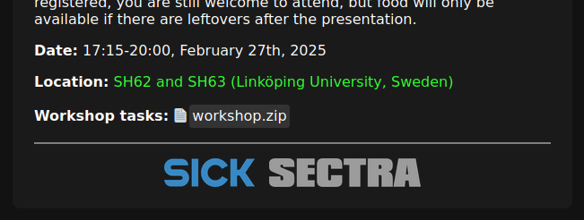

Slide 27
Questions?

